Slide 1
HADOOP
The Hadoop platform was designed to solve problems where you have a lot of data — perhaps a mixture of complex and structured data — and it doesn’t fit nicely into tables. It’s for situations where you want to run analytics that are deep and computationally extensive, like clustering and targeting. That’s exactly what Google was doing when it was indexing the web and examining user behavior to improve performance algorithms.

Slide 2
Applications
Finance: Accurate portfolio evaluation and risk analysis
Online retail: Customer Assistance for Product Search through informed patterns

Slide 3
Architecture Basics
Hadoop is designed to run on a large number of machines that don’t share any memory or disks. That means you can buy a whole bunch of commodity servers, slap them in a rack, and run the Hadoop software on each one. When you want to load all of your organization’s data into Hadoop, what the software does is bust that data into pieces that it then spreads across your different servers. There’s no one place where you go to talk to all of your data; Hadoop keeps track of where the data resides. And because there are multiple copy stores, data stored on a server that goes offline or dies can be automatically replicated from a known good copy.

Slide 4
Architecture Basics cont.
In a Hadoop cluster, every one of those servers has two or four or eight CPUs. You can run your indexing job by sending your code to each of the dozens of servers in your cluster, and each server operates on its own little piece of the data. Results are then delivered back to you in a unified whole. That’s MapReduce: you map the operation out to all of those servers and then you reduce the results back into a single result set.
Architecturally, the reason you’re able to deal with lots of data is because Hadoop spreads it out. And the reason you’re able to ask complicated computational questions is because you’ve got all of these processors, working in parallel, harnessed together.

Slide 5
Component Architecture
Hadoop consists of the Hadoop Common package which provides filesystem and OS level abstractions, a MapReduce engine (either MapReduce or YARN) and the Hadoop Distributed File System (HDFS). The Hadoop Common package contains the necessary Java ARchive (JAR) files and scripts needed to start Hadoop. The package also provides source code, documentation and a contribution section that includes projects from the Hadoop Community. (Source: Wikipedia)

Slide 6
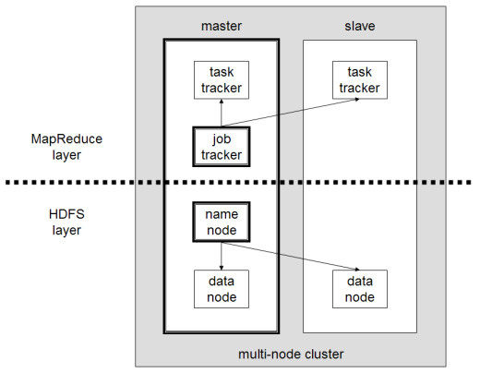
Node Architecture

Slide 7
HDFS Layer
NameNode: a master server that manages the file system namespace and regulates access to files by clients.
DataNodes: usually one per node in the cluster, which manage storage attached to the nodes that they run on.
HDFS exposes a file system namespace and allows user data to be stored in files. Internally, a file is split into one or more blocks and these blocks are stored in a set of DataNodes. The NameNode executes file system namespace operations like opening, closing, and renaming files and directories. It also determines the mapping of blocks to DataNodes. The DataNodes are responsible for serving read and write requests from the file system’s clients. The DataNodes also perform block creation, deletion, and replication upon instruction from the NameNode.

Slide 8
Map reduce Layer
Above the file systems comes the MapReduce engine, which consists of one JobTracker, to which client applications submit MapReduce jobs. The JobTracker pushes work out to available TaskTracker nodes in the cluster, striving to keep the work as close to the data as possible. With a rack-aware file system, the JobTracker knows which node contains the data, and which other machines are nearby. If the work cannot be hosted on the actual node where the data resides, priority is given to nodes in the same rack

